Slide 1

Delivering Equality of Opportunity in Schools (DEIS)
Ballyhaunis Community School

Slide 2

The Purpose of the Session
1. To provide information on:
The DEIS themes
The planning requirements for DEIS schools

Slide 3

What is DEIS?
DEIS
DEIS is the Department’s main policy initiative to respond to educational disadvantage. The DEIS programme focuses on targeting additional resources to those schools included in the programme to ensure every child has an equal opportunity to achieve their potential.
Supports are provided to schools based on the concentration of children and young people in the school at risk of educational disadvantage
Calculated using:
DE enrolment database. Includes children and young people in Direct Provision and from Traveller / Roma Communities
Pobal HP Deprivation index
Data from Department of Housing and Local Government on homelessness

Slide 4
DEIS ACTION PLANING FOR IMPROVEMENT: DEIS THEMES

Slide 5
KEY BACKGROUND DOCUMENTS:
Looking At Our School: A quality framework for post-primary/primary schools (2022)
School Self-evaluation Guidelines SSE Circulars: 39/2016 40/2016 56/2022 – Next Steps
Leadership and Management Circulars 03/2018 (Post-primary)
DEIS Plan 2005
DEIS Plan 2017
SSE Updates Post Primary

Slide 6
ATTENDANCE
Accuracy of attendance data and systems to record and monitor attendance
Analysing attendance data to establish who is most at risk
Awareness of attendance patterns among learners and parents
Attainment - educating parents and learners around the link between good attendance and attainment

Slide 7
RETENTION
Overarching goal is to retain learners in the education system until they complete the Leaving Certificate/Leaving Certificate Applied examinations.
Retention refers to retaining learners within each sector (early years/primary/post-primary) and from one sector to the next.
Retention is relevant at all sectors as patterns such as lateness, partial attendance, family patterns of poor attenders are all predictors for early school leaving. Precursors are evident from early years/ primary

Slide 8
RETENTION
The DE publishes national data on retention each year
Latest publication: Retention rates of pupils in second-level schools; Entry cohort 2014
Overall retention rates are improving in our education system
The retention rate for schools participating in DEIS is 84.8%.
However the gap between DEIS and non-DEIS schools is 8.6% percentage points

Slide 9
LITERACY
“Literacy includes the capacity to read, understand and critically appreciate various forms of communication including spoken language, printed text, broadcast media, and digital media.” (The National Strategy to improve Literacy and Numeracy among children and young people, 2011-2020)
Literacy is a gateway skill to accessing all subjects, therefore whole-school approaches are vital.
Every subject/curriculum area has a literacy component.
Importance of oral language development and building confidence in spoken language.
Supporting EAL pupils in acquiring the language of schooling (English/Gaeilge)
Supporting EAL pupils in maintaining home languages through an asset based approach

Slide 10
NUMERACY
Encourage schools to define numeracy and to ensure that a whole-school approach is adopted.
Being numerate is:
Expressing ideas mathematically
Estimating, predicting and calculating
Developing a positive disposition towards investigating, reasoning and problem-solving
Seeing patterns, trends and relationships
Gathering, interpreting and representing data
Using digital technology to develop numeracy skills and understanding
(Framework for Junior Cycle, 2015)

Slide 11
EXAMINATION ATTAINMENT (PP)
Use of school’s own data to examine trends
Uptake levels of higher and ordinary
Attainment levels
Whole-school approach
Subject department approach
Tracking students at individual level and goal setting
Role of teaching and learning
Setting high expectations from first year

Slide 12
LEADERSHIP, CPD AND WELLBEING
These three themes were added in 2017 for DEIS planning
These themes should be integrated across the other themes of DEIS.
Schools are not required to gather separate data on these themes for the purposes of DEIS planning

Slide 13
WELLBEING
Evidence based programmes such as Friends for Life/SPHE/NEPS programmes
Feeling welcome in the school
School climate
Learner experience in the classroom
Learner engagement

Slide 14
CPD
Has the school identified priorities for CPD?
How is it linked to the targets in the DEIS plan?
Uptake at leadership level of relevant CPD
Staff uptake
NCSE
PDST

Slide 15
DEIS ACTION PLANNING FOR IMPROVEMENT
Requirements as outlined in the DEIS Grant Letter and in SSE guidance

Slide 16
Letter to schools:
Schools in the DEIS programme are required to develop and implement three-year improvement plans as a condition of their participation in DEIS.
It is the school’s improvement plan
No additional plan is required for SSE / Gaeltacht recognition
Schools should integrate a wellbeing promotion review and development cycle into DEIS planning process
Meaningful document that reflects the context and guides practice

Slide 17
DEIS Action Planning Requirements
Each school’s DEIS Action Plan for Improvement should have a separate section for each of the following themes:
• Attendance
• Retention
• Literacy
• Numeracy
• Supporting educational transitions
• Partnership with parents and others
• Examination Attainment (post-primary only)
The following three themes should be included in an integrated manner in each school’s DEIS Action Plan for Improvement:
• Leadership
• Continuing professional development (CPD)
• Wellbeing.

Slide 18
DEIS PLANNING REQUIREMENTS
Identify most at risk pupils for targeting of additional resources
Identify the needs of these pupils
Identify the priority areas to meet these needs
Devise clear targets based on robust evidence to meet the identified needs
Identify and plan for the implementation of interventions to meet these targets
Monitor the success of these interventions

Slide 19
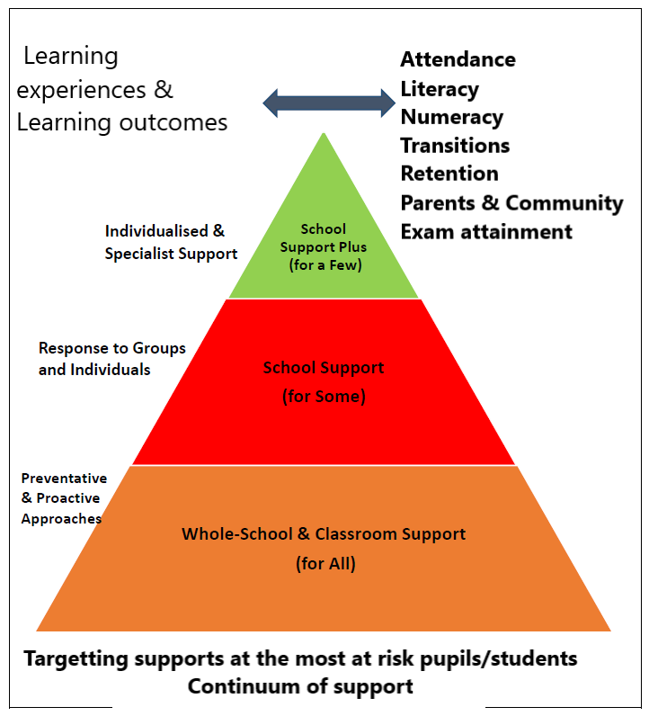
Who are the most at risk pupils/students?
Context informed
Level of disadvantage identified
  DEIS Band 1
  DEIS Band 2
  Rural DEIS
Size of school

Slide 20

Target pupils
Using baseline data and other information, the students most at risk are identified and supports targeted at their specific needs
In terms of partnerships with parents, the target parents/families are identified – approx. 25 in larger schools
Red – High risk | Amber - Intermediate Risk | Green – Low Risk

Slide 21
ALIGNMENT OF SSE AND DEIS ACTION PLANNING
Schools are asked to use the six-step SSE process as a tool to support DEIS action planning for improving outcomes for pupils:
Identify focus
Gather evidence from a range of sources
Analyse and make judgements
Devise DEIS Action Plan for Improvement with clear (SMART) targets for each theme based on steps 2 and 3
Implement strategies/interventions that are aligned to the targets
Monitor and evaluate improvements in outcomes for students

Slide 22

Setting clear (SMART) targets
Some examples from a DEIS action plan
3% of children received a score of less than 70 in standardised tests in June 2021. Our target is to reduce this score to 2% or under at the end of 2022
51% of children got a standard score between 110/119 in 2018, 2019 and 2021. Our target is to increase this score to 52% by the end of the school year

Slide 23
Key Messages
1. All DEIS supports must be targeted at those children and young people most at risk of educational disadvantage.
2. All DEIS schools must have a three-year DEIS Action Plan for Improvement – no separate plan is required for SSE
3. The planning process should be informed by meaningful data
4. The plan should inform classroom and whole-school practice
5. All schools must engage with all DEIS themes – small schools may initially prioritise particular themes relevant to their context

Slide 24
Questions to Analyse where you are as a school
How well are we doing? How do we know?
What are our strengths? How can we build on our strengths?
What are our areas of improvement?

