Slide 1

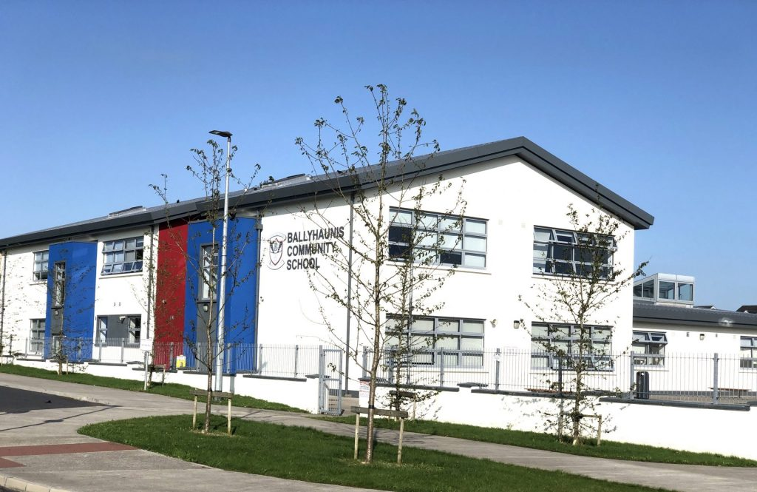

Transition Year 2025/26
Information Evening
Mr. Caulfield
Ballyhaunis Community School

Slide 2
Transition Year
Department of Education Definition
TY is a one year school based programme between Junior and Leaving Cycle.
It is designed to act as a bridge between the two by facilitating the smooth transition from the more dependent learning of the Junior Cycle to the more independent self directed learning required for the Senior Cycle.

Slide 3
Transition Year Programme
Opportunity for students to mature and experience different types of learning – group work/project work/IT based work/independent learning etc.
Break from the pressures of formal education & State Examinations.
Core subjects retained – homework/Research Projects - Regular Assessment & feedback (P/T meetings, semester exams, exam reports & Project Work).
It is NOT a doss year!!

Slide 4
Transition Year Programme
TY students are statistically proven to achieve higher LC points.
On average 20% higher results achieved from ex-TY students.
Remember:
Transition Year is broken into 3 semesters where each students gets to experience three different timetables.
You get out, what YOU put in!

Slide 5
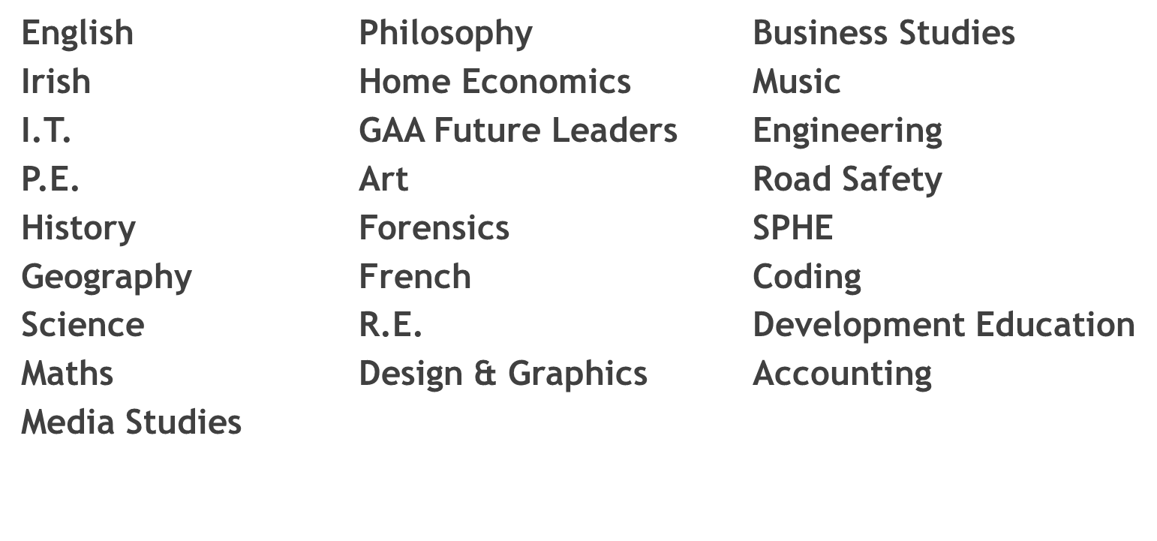
Sample Subjects
* These subjects may vary year to year.

Slide 6
Sample TY Activities
Work Experience | TEFL
Delphi Trip | Movie Making Workshop
IACT Modules | First Aid Course
Junk Kouture | GAA Future Leaders
Enterprise Awards | Driving Lessons
Barista Workshop | Charity Fundraisers
Swimming/Horse Riding | CSI Workshop
Mental Health Workshop | Coaching Courses
Community Care | Bodhran Making Workshop
Plus many more….

Slide 7
Work Experience
Transition Year Students get the opportunity to attend work experience for 1 day every week for 20 weeks during the year.
Work experience gives the students the opportunity to experience potential career choices and life experiences.
Community Care
Community Care takes place for 2 hours for a 10 week period.
Community care gives the students the opportunity to volunteer their time around the community
We have had great support from local business such as:
    MSPCA
    Scoil Iosa Ballyhaunis
    Western Care
    Little Acorns Children's Centre

Slide 8
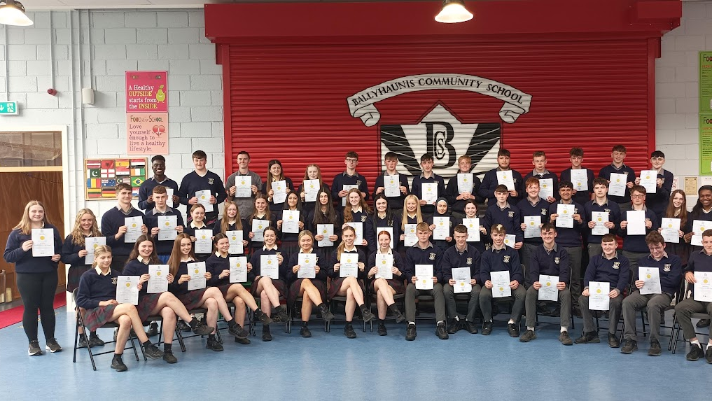
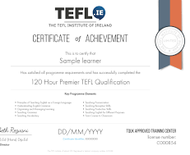
120 Hour TEFL Course
For more information visit www.tefl.ie

Slide 9
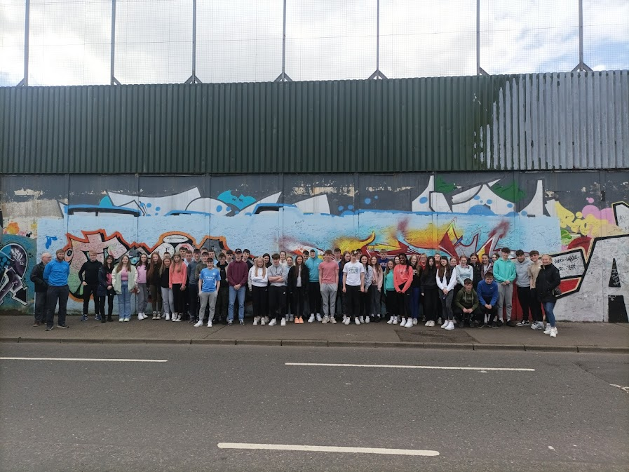
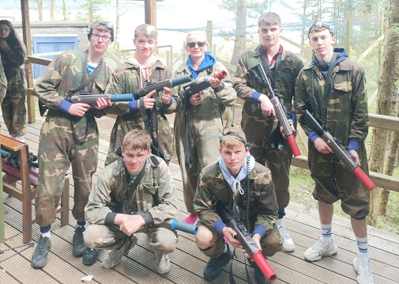
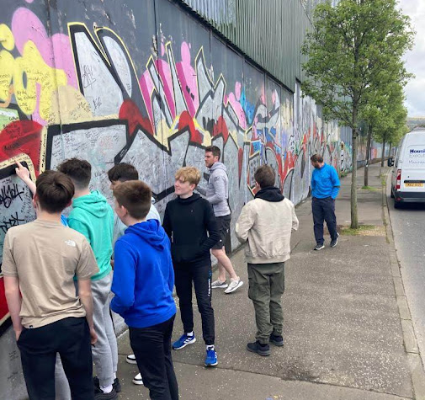
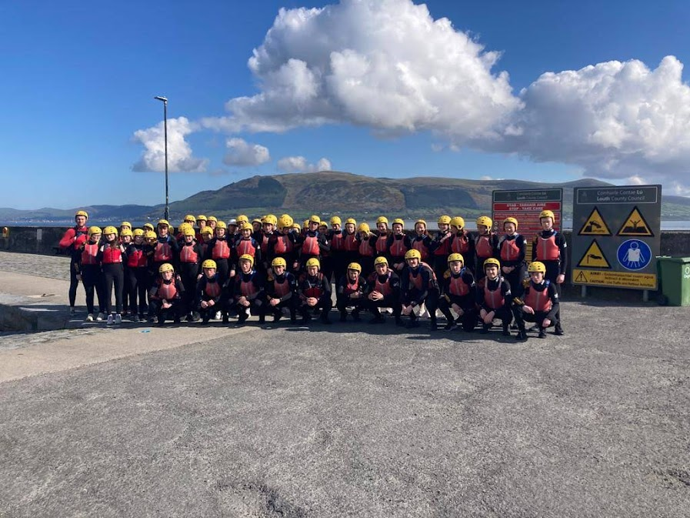
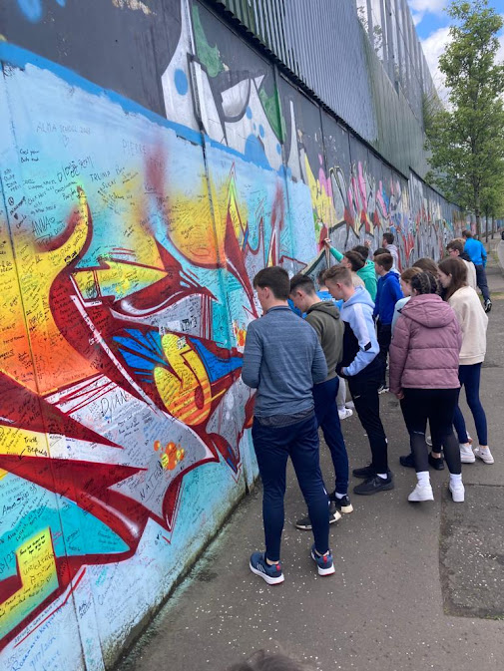
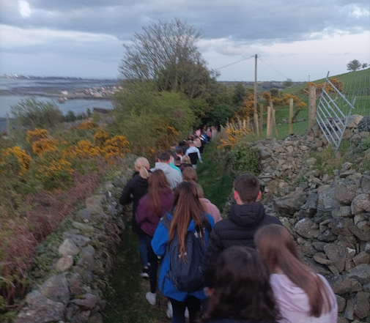

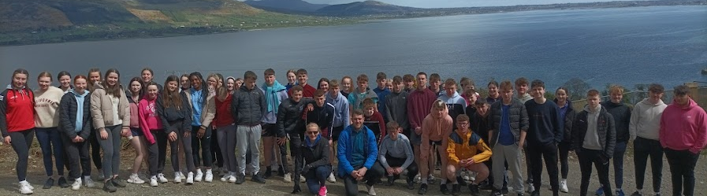
TY History Trip to Belfast and Carlingford

Slide 10
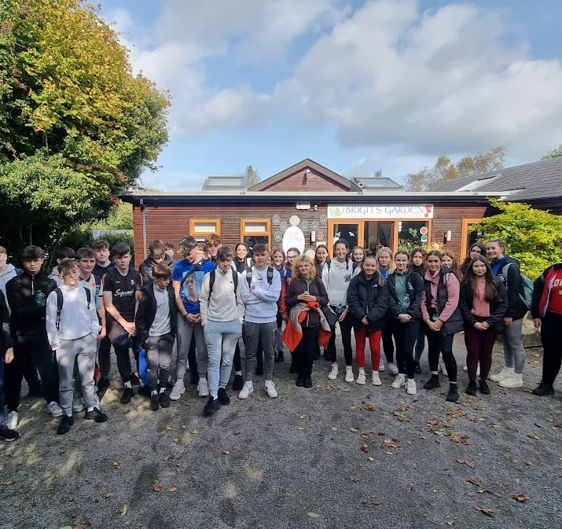
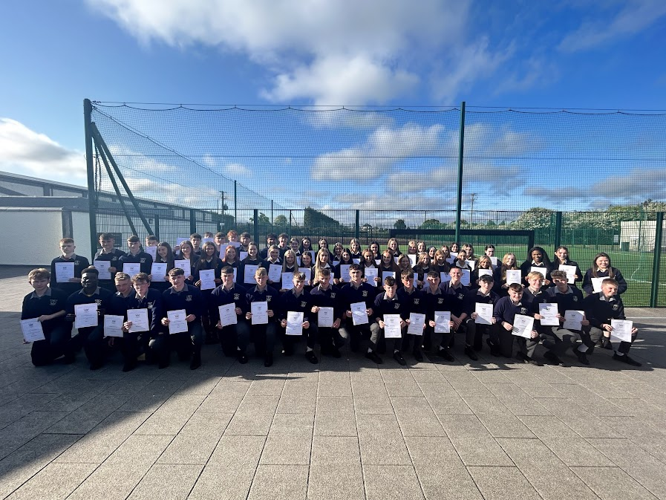
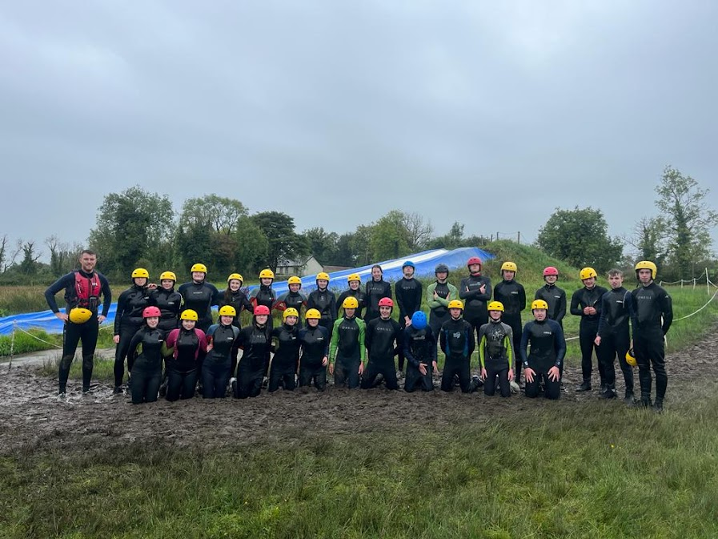
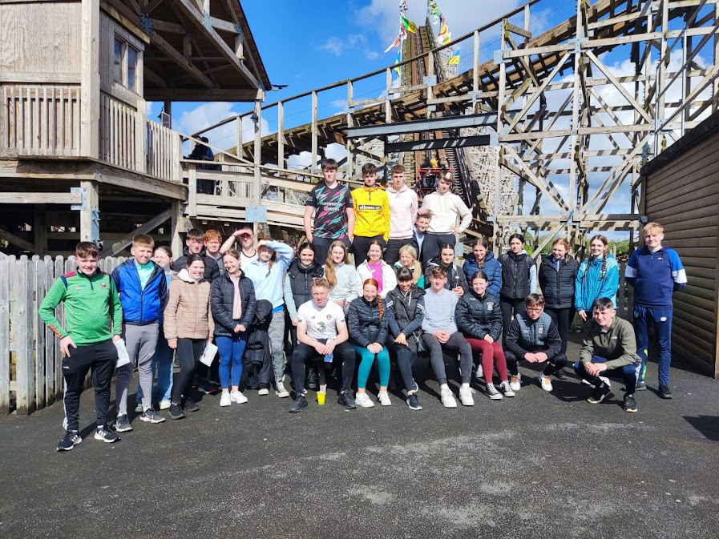
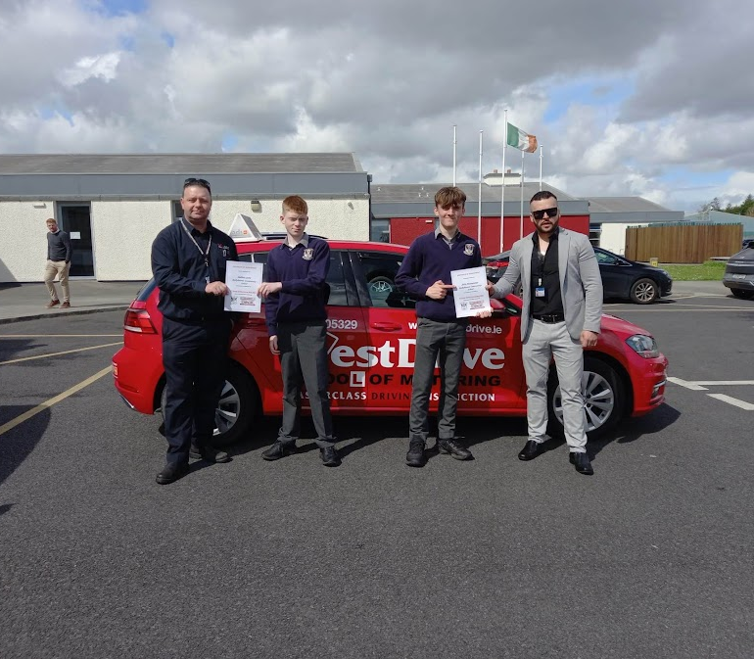
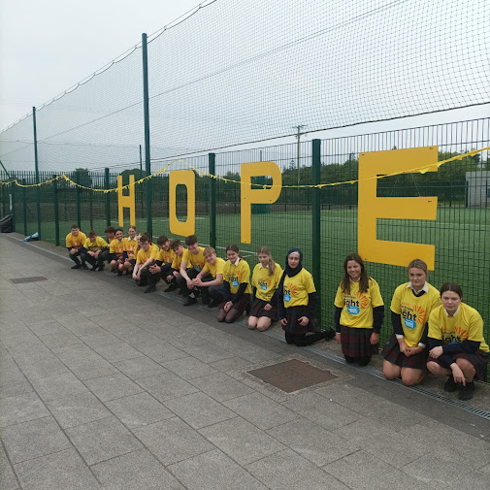
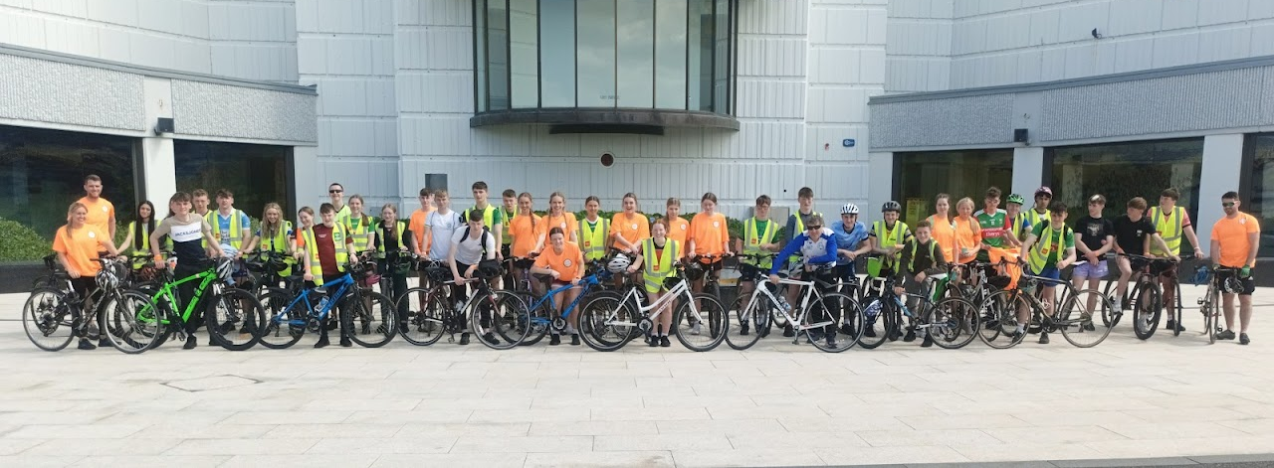
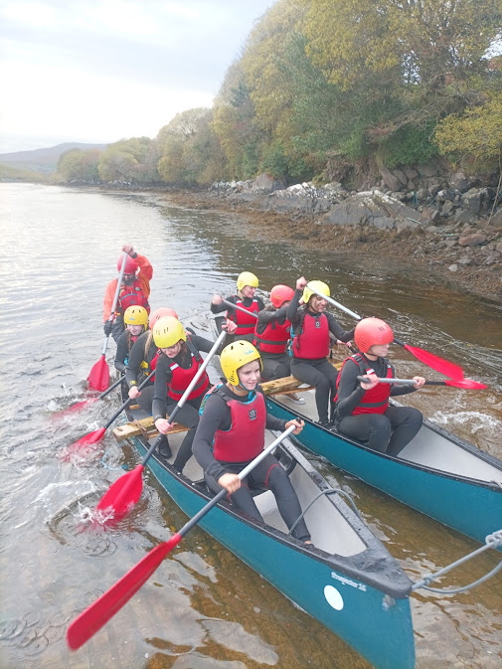
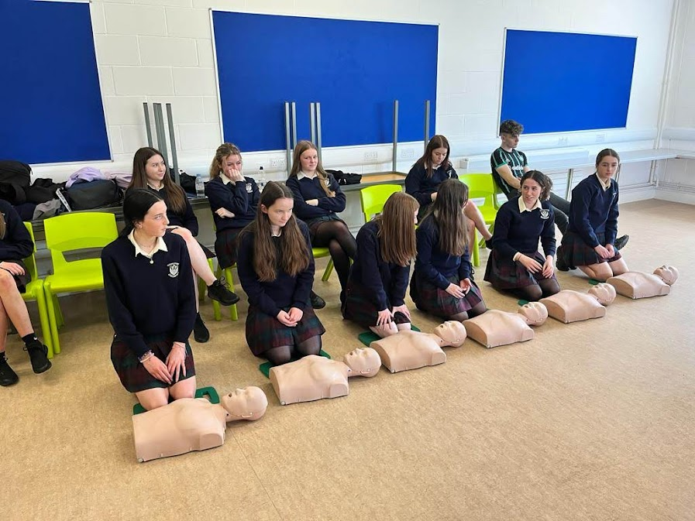
TY Trips & Workshops

Slide 11
TY Students Experiences
“I loved the wide variety of new subjects”
“I loved the Work Experience”
“I made SO many new friends, students I had never spoken to in Junior Cycle”
“I wish I could do it again!”
“New friends!”
“Community Care was brilliant”
“My parents say I matured an awful lot!”
“I learned so many new IT skills”
“Killary was amazing!”

Slide 12
Leaving Certificate Student Survey

Slide 13
Present Leaving Certificate Parent Survey
“It was the best investment in my child's education that I could ever have made.”

Slide 14
TY Cost
Approximate cost of the year = €750 - ALL activities included
Initial deposit of €200 - due in May 2025
Second deposit of €200- due in September 2025
Third Payment of €200 – due in November 2025
Forth Payment of €150 – due in February 2026
This payment includes the following:
Book Rental, Certified Courses such as TEFL, First Aid, IACT. Activities/Trips/ Excursions & Workshops including Shannon Adventure, Delphi Adventure, Drama Workshop, Bodhran Workshop, Movie Making Workshop, Barista Workshop, Mental Health Workshop, Drivers Education Course, CSI Workshop, Knocknarea Climb.
Optional Foreign Trip will be available to all TY students This Year

Slide 15
Erasmus Projects
Foreign Trip
The Foreign trip will be available again this year for all Transition Year students
This trip is optional and is organised through an external company. This is an additional cost to the Transition Year Payments.
This year’s Transition Year students have been given the option to go to London.
We have developed a network of partnering schools in Spain, France, Italy and the Reunion Island where we work collaboratively on various projects through the years.
All TY students get the opportunity to participate on these projects.
This year the students have the opportunity to go to Brussels on an EU Project.
These trips are EU funded and are free for our students. Approx. 8-10 students will travel on this trip.
In 2025/26 we plan on embarking on a variety of new exchange projects.

Slide 16
Application Process
Application Form
Application forms are available on our website. Students will receive Applications before February Mid-Term Break
Interview
Interviews will take place during March 2025

Slide 17
For more information please visit our website
www.ballyhauniscs.ie
or email
c.caulfield @ballyhauniscs.ie

